Slide 1
Tracking in 3D+t Biomedical Data
Marcelo da Mata Oliveira

Slide 2
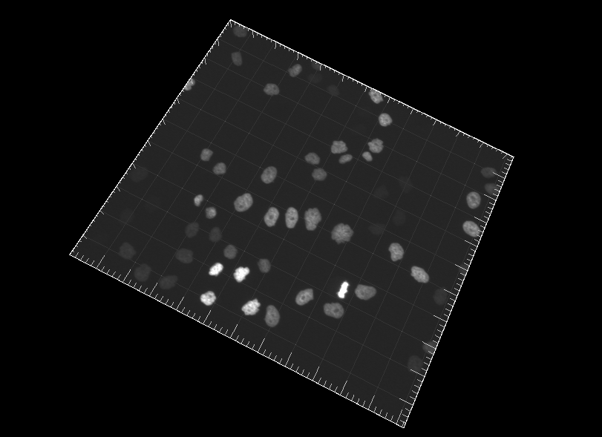
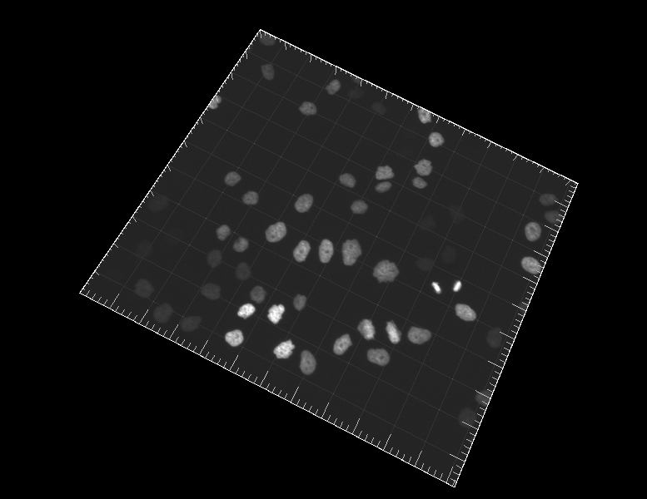
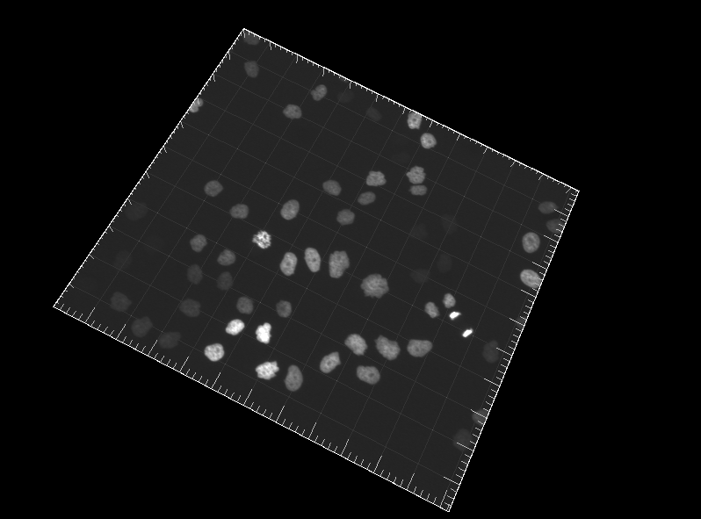
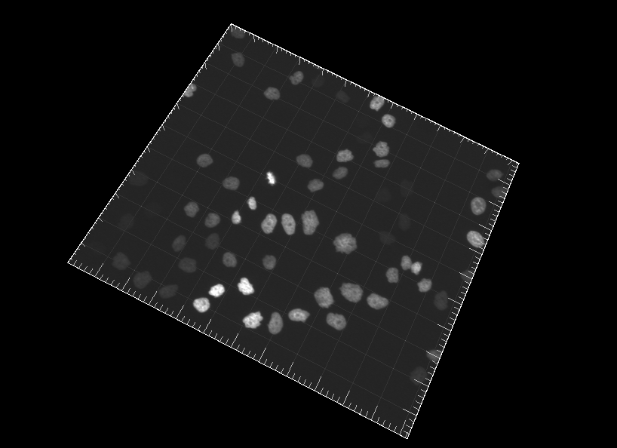
Introduction and Motivation
Large acquisition of biomedical data
3D+t images
Complex cellular dynamics
Analyse the data to increase de understanding about the biological process
Many computational challenges
Tracking

Slide 3
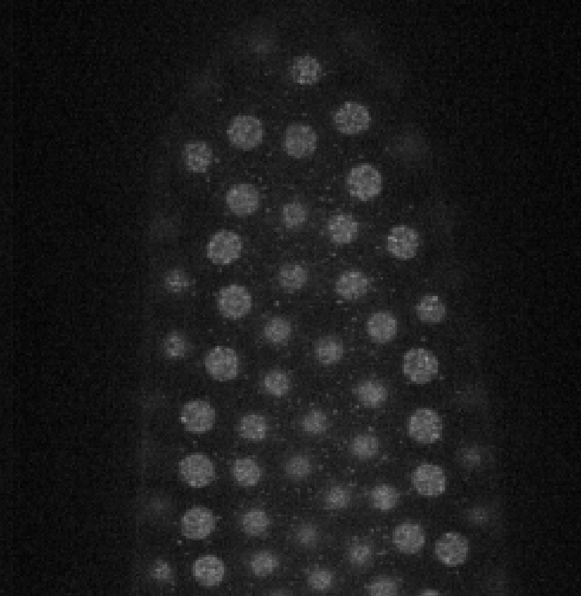
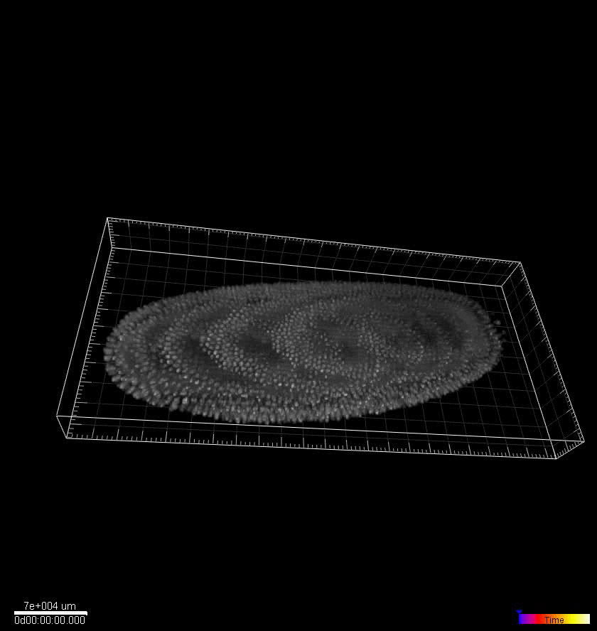
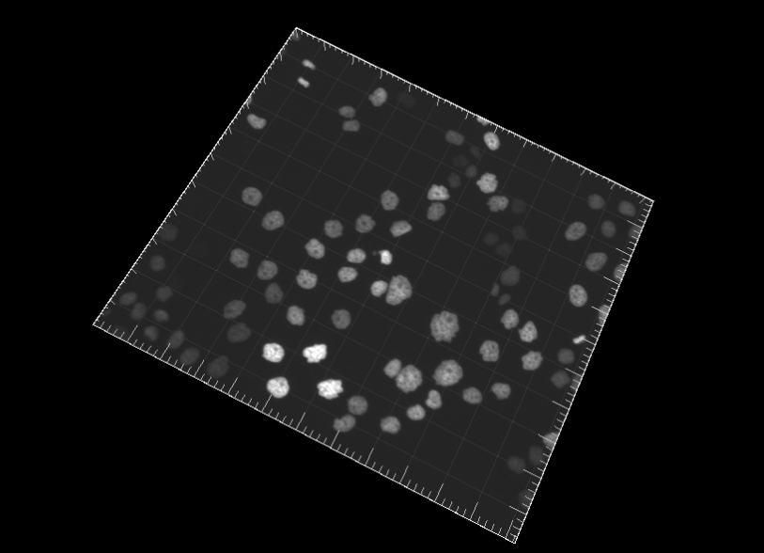
Challenges
Too noisy images
High cells density
Overlap
Division
Variety of behavior
Different type of cells

Slide 4
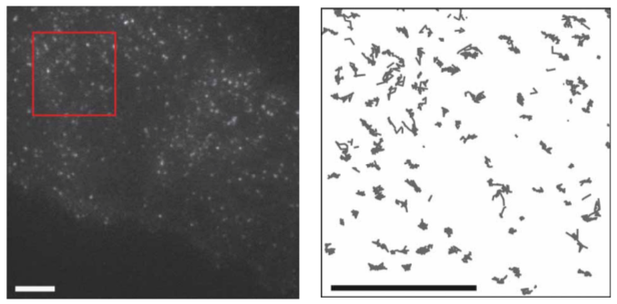
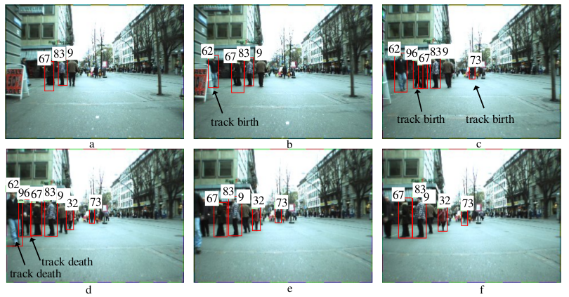
Related works
Biomedical data
Robust single-particle tracking in live-cell time-lapse sequences (Jaqaman et al, 2008)
Other applications
Globally-Optimal Greedy Algorithms for tracking a variable number of objects (Pirsiavash et al 2011)

Slide 5
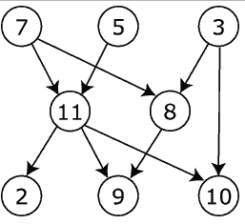
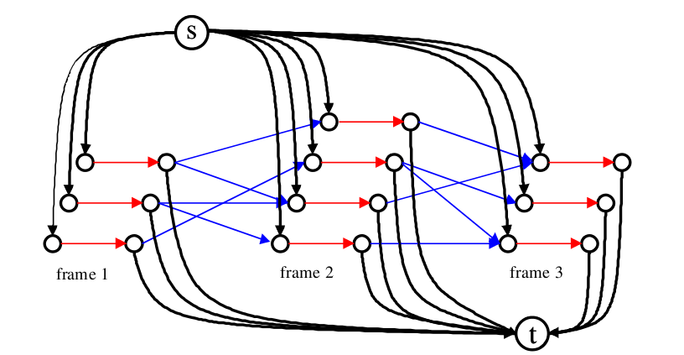
Optimization problem
Dense direct acyclic graph
Nodes – particles detected per frame
Edges between particles in frame t and t+n
Optimization problem
Model the graph
Algorithm

Slide 6
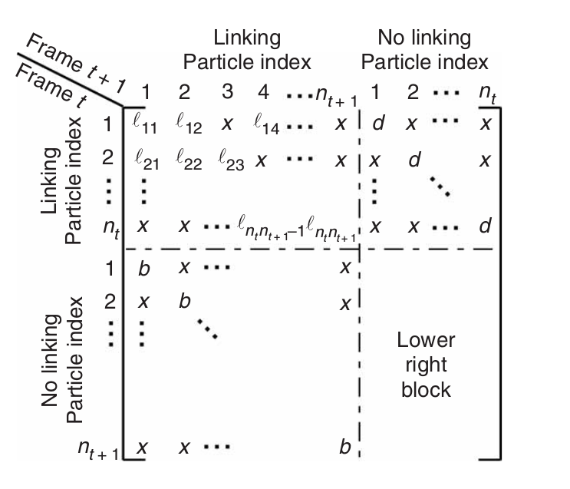
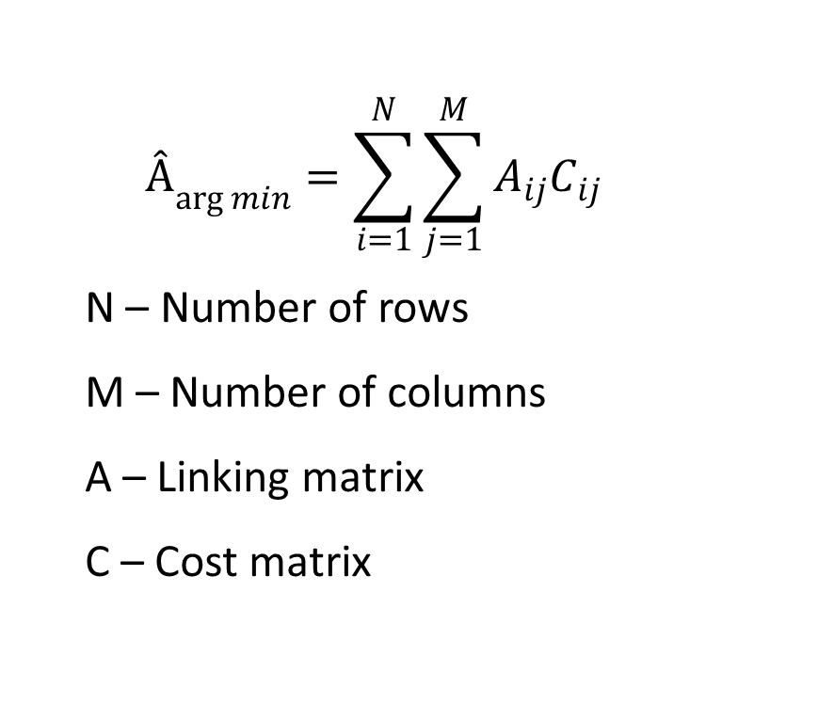
Jaqaman approach
$${Â­}_{\arg{min}}=\sum_{i=1}^{N}{\sum_{j=1}^{M}{A_{ij}C_{ij}}}$$
N – Number of rows
M – Number of columns
A – Linking matrix
C – Cost matrix

Slide 7
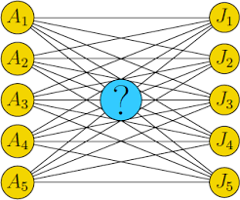
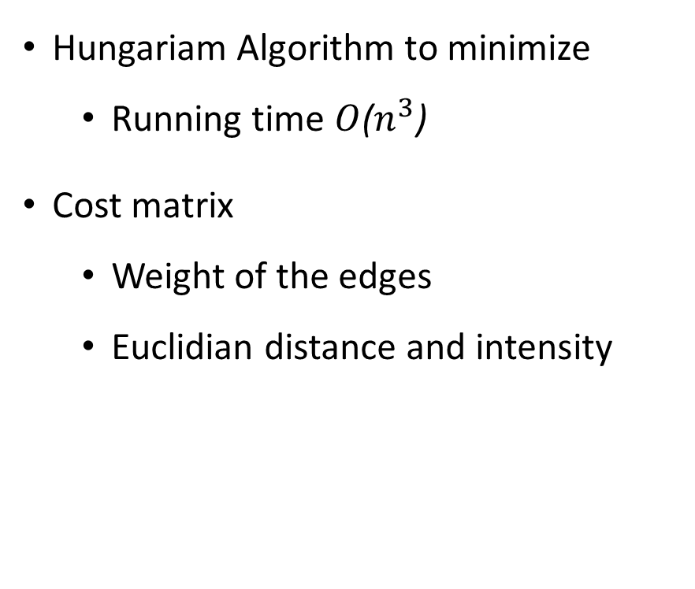
Jaqaman approach
Hungariam Algorithm to minimize
Running time $O$($n^{3}$)
Cost matrix
Weight of the edges
Euclidian distance and intensity

Slide 8
Current work
Implement a framework
Jaqaman approach
Define a model
Incorporate problems of cells behavior
Define a matrix C to improve current results
Use other features
Colocalization
Shape
Velocity

Slide 9
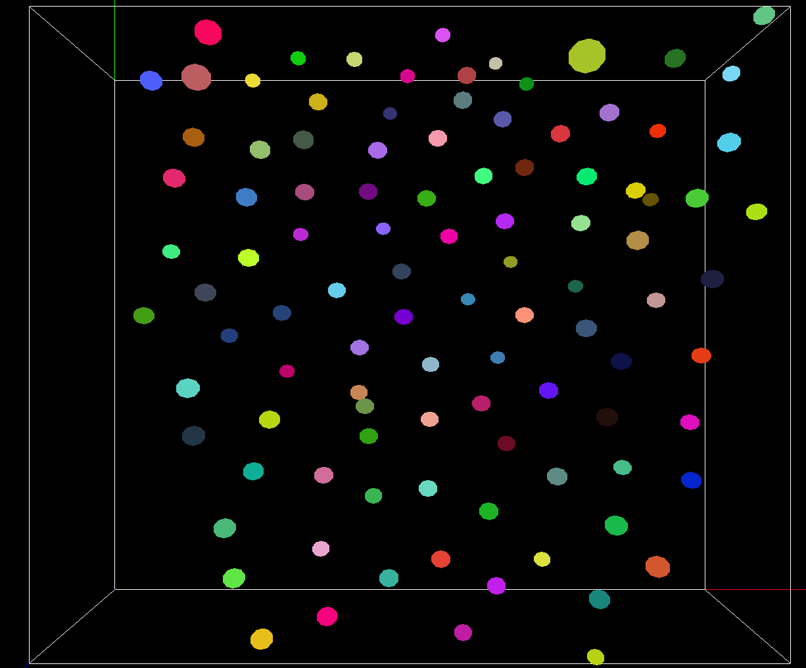
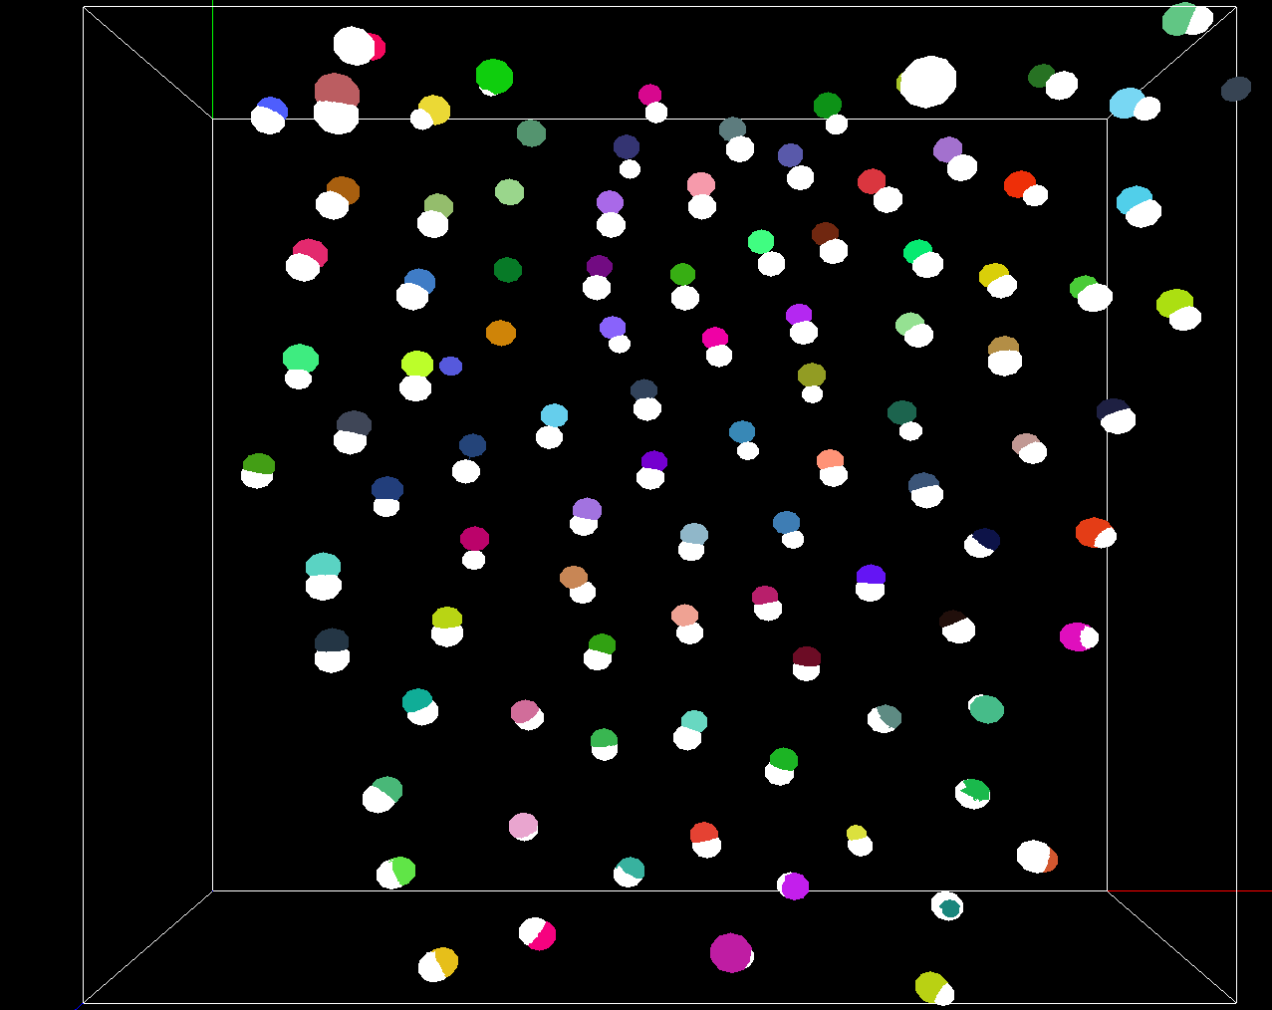
Partial results

Slide 10
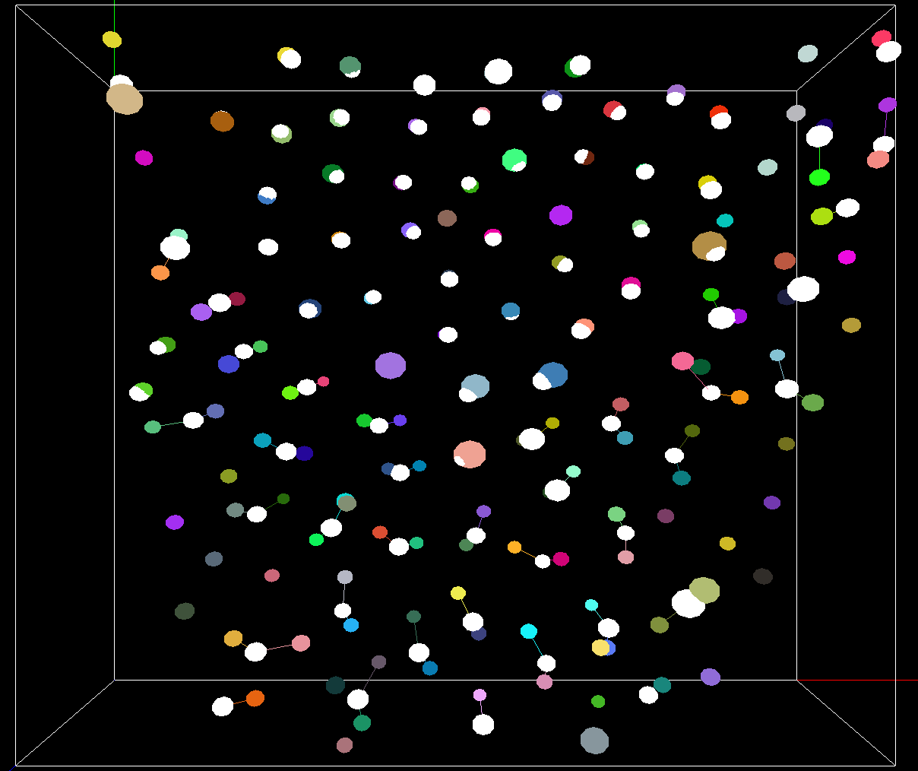
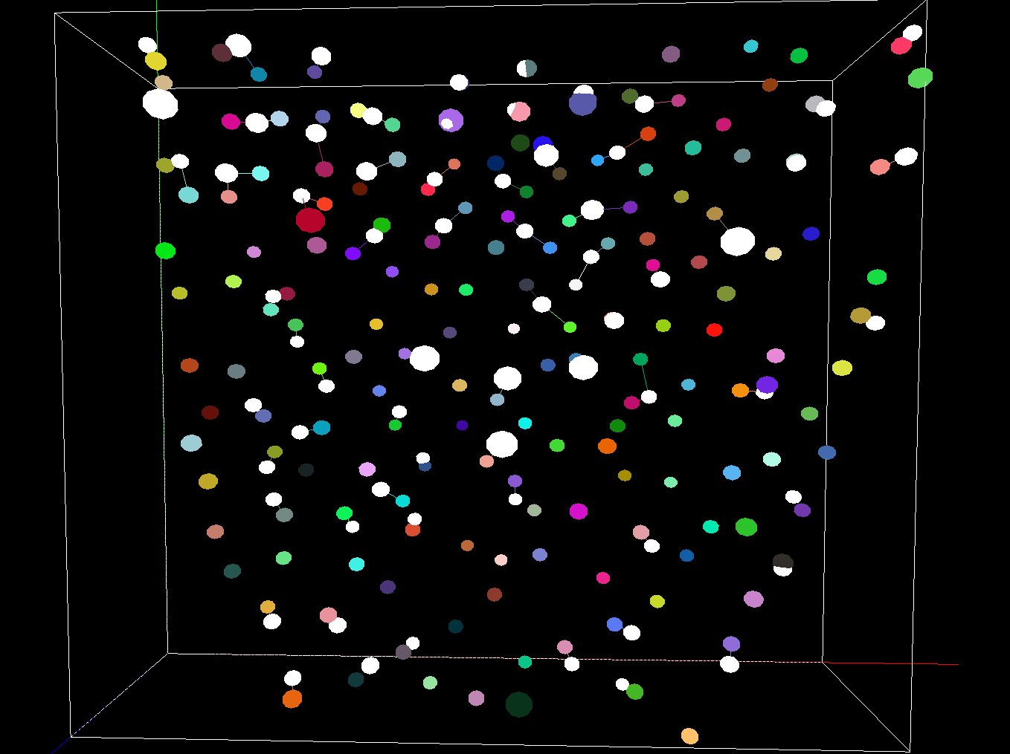
Partial results

Slide 11
Future works
Adapt the Jaqaman approach
Uses the Pirsiavash algorithm
Running time O(K N log N), K is the number of paths

